Slide 1
Lecture 7
Understanding Human being as the Co-existence of the Self and the Body

Slide 2
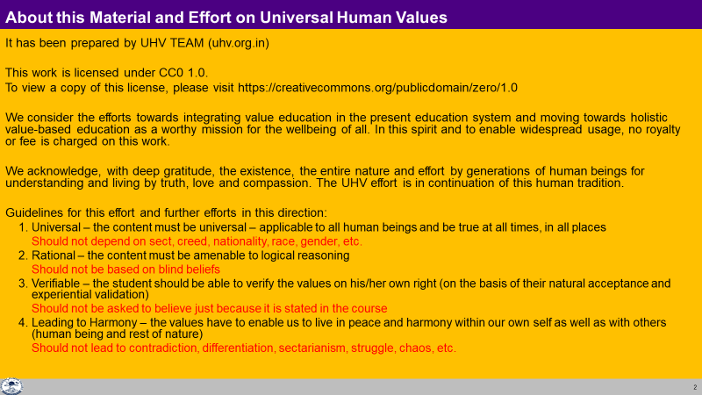

Slide 3
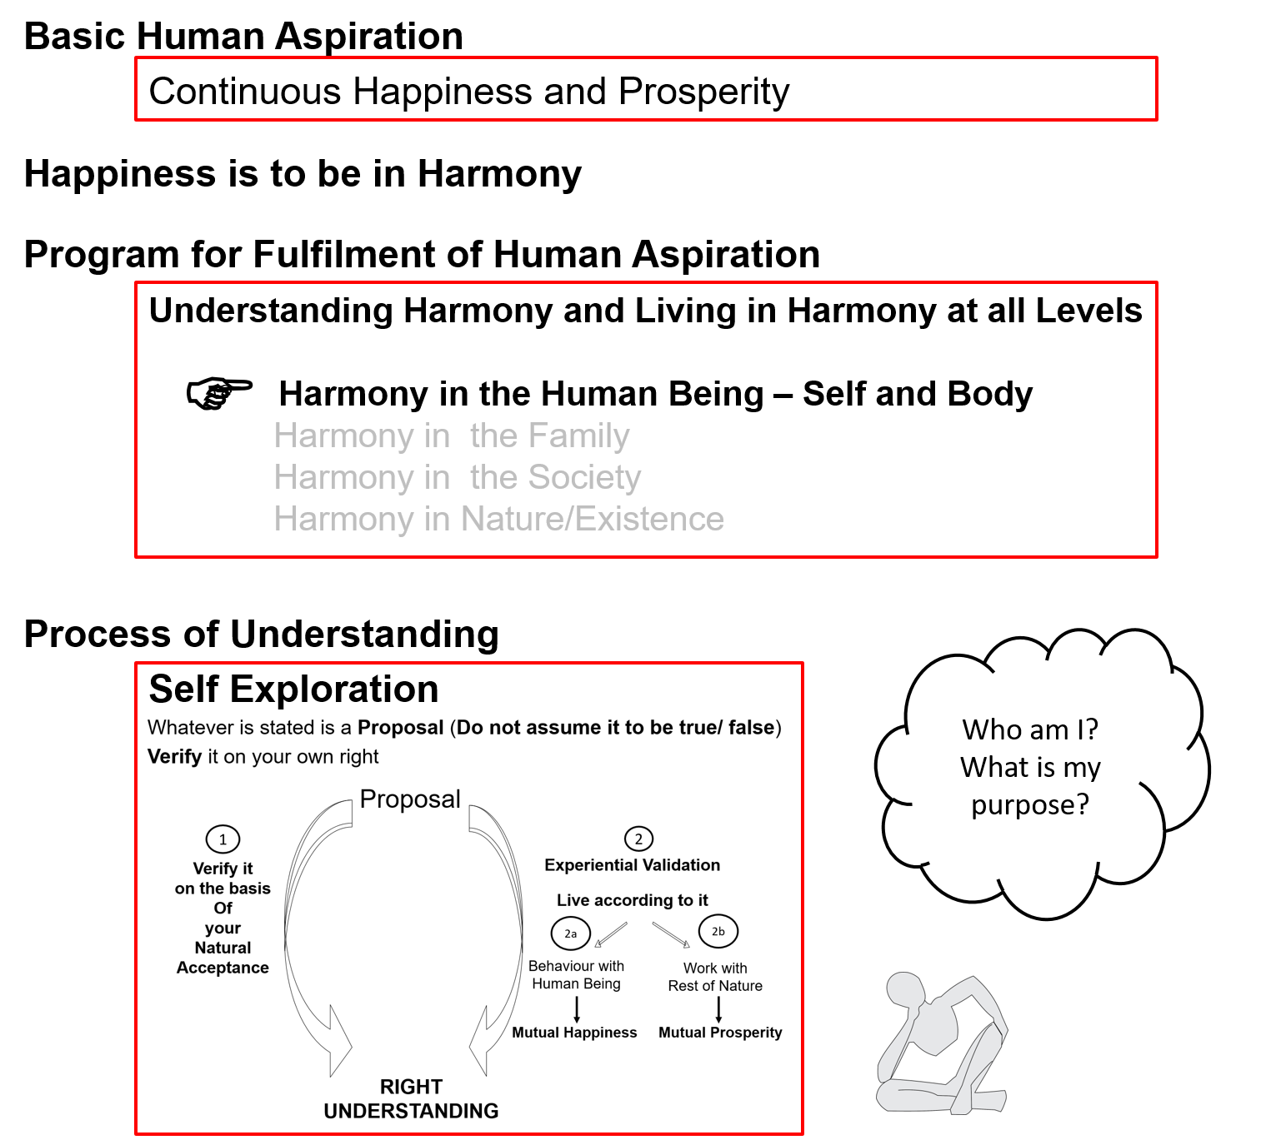
Notes:
2 mins: Key points
Basic human aspiration = continuous happiness and prosperity
Happiness = to be in harmony
Levels of our living (4 levels) = individual, family, society and nature/existence
Therefore, to live in harmony in continuity, we need to understand harmony at these 4 levels
Process of understanding = self-exploration
In this session, we will explore into harmony at the first level “harmony in the human being”
Let us focus on OURSELF, without bringing in any second person (we will do that when we get to the family, not now)
(do not elaborate on any point)

Slide 4
Human Being Ekkuo | Self eSa | Body “kjhj
Co-existence
lgvfLrRo
Notes:
Key point
Human Being = co-existence of self and body
The body is a reality, the self is a reality and they co-exist (both exist simultaneously in the form of a human being)
Pause – let participants absorb this key point – help them to explore
Do not ask them if they can see this immediately – the session will become evaluative
We will explore these realities throughout this session

Slide 5

Human Being Ekkuo | Self eSa | Body “kjhj
Need vko';drk | Happiness (e.g. Respect) lq[k ¼tSls lEeku½ | Physical Facility (e.g. Food) lqfo/kk ¼tSls Hkkstu½
In Time dky esa | Continuous fujUrj | Temporary lkef;d
In Quantity ek=k esa | Qualitative (is Feeling) xq.kkRed ¼Hkko gS½ | Quantitative (Required in Limited Quantity) Ekk=kRed ¼lhfer ek=k esa½
Co-existence
lgvfLrRo
Are these needs of different types or of same type?
Are both types of needs important / Do we want fulfillment of both types of needs?
Are we working to fulfill both types of needs?
What is the priority between the needs of the Self & the needs of the Body?
Notes:
Key point
To explore into both these realities, we can first look at their needs
Elaboration
We can see that as a human being we have 2 types of needs [explain the 3 points for what they are]
1. one is a need for PF and another is a need for Happiness (feelings like respect…) – give small example to clarify, pause and move on
2. One need is temporary (required from time to time) and another is a continuous need - give small example to clarify, pause and move on
3. One need is quantitative (can be measured) and another is qualitative (If I need it, I always want it, otherwise I never want it) – give small example to clarify, pause and move on
Ask the 4 questions in the slide, discuss to CLARIFY each point, DO NOT TRY TO CONVINCE
Do not bring in any other information (like exchange of information between self and body, etc.)

Slide 6
Human Being Ekkuo | Self eSa | Body “kjhj
Need vko';drk | Happiness (e.g. Respect) lq[k ¼tSls lEeku½ | Physical Facility (e.g. Food) lqfo/kk ¼tSls Hkkstu½
In Time dky esa | Continuous fujUrj | Temporary lkef;d
In Quantity ek=k esa | Qualitative (is Feeling) xq.kkRed ¼Hkko gS½ | Quantitative (Required in Limited Quantity) Ekk=kRed ¼lhfer ek=k esa½
Fulfilled By iwfrZ ds fy, | Right Understanding & Right Feeling lgh le>] lgh Hkko | Physio-chemical Things HkkSfrd&jklk;fud oLrq
Co-existence
lgvfLrRo
The needs of the Body can not be fulfilled by Right Understanding, Right Feelings alone
The needs of the Self can not be fulfilled by Physio-Chemical Things
Both type of needs have to be understood separately
Both type of needs have to be fulfilled separately
In living, what is the priority?
  How much time & effort is spent for right understanding & right feelings?
  How much time & effort is spent for physical facility?
Notes:
Key point
Need of the Body is fulfilled by physio-chemical things
Need of the Self is fulfilled by RU and RF
We will explore into these points throughout the FDP, so no need to close this here, leave it for further exploration

Slide 7
Human Being Ekkuo | Self eSa | Body “kjhj
Need vko';drk | Happiness (e.g. Respect) lq[k ¼tSls lEeku½ | Physical Facility (e.g. Food) lqfo/kk ¼tSls Hkkstu½
In Time dky esa | Continuous fujUrj | Temporary lkef;d
In Quantity ek=k esa | Qualitative (is Feeling) xq.kkRed ¼Hkko gS½ | Quantitative (Required in Limited Quantity) Ekk=kRed ¼lhfer ek=k esa½
Fulfilled By iwfrZ ds fy, | Right Understanding & Right Feeling lgh le>] lgh Hkko | Physio-chemical Things HkkSfrd&jklk;fud oLrq
Activity fØ;k | e.g., Imagination (Desire, Thought, Expectation)… dYiuk”khyrk ¼bPNk] fopkj] vk”kk½--- | e.g., Eating, Walking… [kkuk] pyuk---
In Time dky esa | Continuous fujUrj | Temporary lkef;d
Co-existence
lgvfLrRo
Notes:
Key Points
To see the characteristics of Self and Body, we can study their activities also
Activity of the Body is one type (it is temporary – body gets tired after some time)
Activity of the Self is another type (it is continuous) – participants may or may not be able to see this so do not harp on this
Just ask them to see if they imagine, have desires, thoughts, expectations and let them keep exploring
We will explore into these points throughout the FDP, so no need to close this here, leave it for exploration

Slide 8
Human Being Ekkuo | Self eSa | Body “kjhj
Need vko';drk | Happiness (e.g. Respect) lq[k ¼tSls lEeku½ | Physical Facility (e.g. Food) lqfo/kk ¼tSls Hkkstu½
In Time dky esa | Continuous fujUrj | Temporary lkef;d
In Quantity ek=k esa | Qualitative (is Feeling) xq.kkRed ¼Hkko gS½ | Quantitative (Required in Limited Quantity) Ekk=kRed ¼lhfer ek=k esa½
Fulfilled By iwfrZ ds fy, | Right Understanding & Right Feeling lgh le>] lgh Hkko | Physio-chemical Things HkkSfrd&jklk;fud oLrq
Activity fØ;k | e.g., Imagination (Desire, Thought, Expectation)… dYiuk”khyrk ¼bPNk] fopkj] vk”kk½--- | e.g., Eating, Walking… [kkuk] pyuk---
In Time dky esa | Continuous fujUrj | Temporary lkef;d
Response* | Not always Definite (depends on assuming**) | Definite
Co-existence
lgvfLrRo
* Response = Recognising the relationship with the other unit and fulfilling it
** Assuming or acceptance of relationship
Notes:
Key points
Response = Recognising the relationship with the other unit and fulfilling it
The response of the Body is definite – give an example
There is a choice in the response of the Self – it is based on assuming – give an example
Elaboration, Discussion Points, Examples
We have written
"Response - choice based on acceptances (assuming)"
There is a choice in the response of the Self
e.g. If someone is using abusive language, the Self has a choice to abuse back or to keep quiet, etc.
- When a stranger uses an abuse, you may shout back
- When a good friend uses the same word, it may elicit a smile
The choice of the Self depends on the acceptance (assuming)
You have assumed the stranger is abusing you
You have assumed your friend is using the abusive language quite casually
The response of the Body is definite (there is no choice)
- Each type of food will have a definite impact on the Body (belladonna will worsen your body, rice will nurture your body)
(while you can always choose what to eat)
For UHV-III
We can further elaborate
"Response - choice based on one's world-view (assuming)"
world-view based on reality (jaisi shrshti vaisi drishti) or
world-view based on some assumption of the reality (which may or may not match the reality)
After sanskar has been introduced, we can also include
"Response - choice based on one's sanskar"
(pure sanskar or not so pure sanskar)

Slide 9
Human Being Ekkuo | Self eSa | Body “kjhj
Need vko';drk | Happiness (e.g. Respect) lq[k ¼tSls lEeku½ | Physical Facility (e.g. Food) lqfo/kk ¼tSls Hkkstu½
In Time dky esa | Continuous fujUrj | Temporary lkef;d
In Quantity ek=k esa | Qualitative (is Feeling) xq.kkRed ¼Hkko gS½ | Quantitative (Required in Limited Quantity) Ekk=kRed ¼lhfer ek=k esa½
Fulfilled By iwfrZ ds fy, | Right Understanding & Right Feeling lgh le>] lgh Hkko | Physio-chemical Things HkkSfrd&jklk;fud oLrq
Activity fØ;k | e.g., Imagination (Desire, Thought, Expectation)… dYiuk”khyrk ¼bPNk] fopkj] vk”kk½--- | e.g., Eating, Walking… [kkuk] pyuk---
In Time dky esa | Continuous fujUrj | Temporary lkef;d
Response | Knowing, Assuming*, Recognising, Fulfilling tkuuk] ekuuk] igpkuuk] fuokZg djuk | Recognising, Fulfilling igpkuuk] fuokZg djuk
Co-existence
lgvfLrRo
* Assuming or accepting the relationship with the other unit
– could be based on knowing the reality or without knowing the reality completely
Notes:
Key points
Here we are only elaborating on Response by adding Knowing, assuming (accepting) in the Self
The response of the Self depends on its acceptance (assuming)
If this acceptance is based on knowing that reality in its completeness, the acceptance is definite, unchanging
Knowing = directly knowing what the reality is (e.g., what is human being) = right understanding

Slide 10
Knowing & Assuming (Accepting)
Knowing, Assuming, Recognizing, Fulfilling
Problem leL;k
Education-Sanskar
Resolution
lek/kku
Preconditioning or
Assuming without Knowing
Assuming keep changing
Conduct is indefinite (Dependence, Partantrata)
Knowing through self-exploration
(verifying on the basis of Natural Acceptance and validating in living)
Assuming becomes definite
(on the basis of Knowing)
Conduct is definite (Self-Organisation, Swatantrata)
Notes:
Key point: Response depends on our assuming (explained in UHV-Intro also)
(do not try to close what is knowing here, as we will discuss about the reality (knowing) throughout in UHV-Intro, UHV-II, UHV-III.
We will explore if knowing is something definite and if it can settle the acceptance (assuming), and lead to resolution, definite conduct)
Note: The doctor example is only to highlight that response changes when there is a shift in assuming. It is not about shift from assuming to knowing
So far, we have shared the proposal about the reality human being (we are yet to propose more details about the Self, and later the relationship between human beings, society, nature and existence, so at this point, we can give some examples about knowing
If we can see that the “human being is the co-existence of the Self and Body”, we will always be aware of
The need of every Self is happiness – and it is fulfilled by RU and RF; we will not have different assumptions about different human beings
e.g., we will not have different assumptions about rich-poor, people from one sect-people from another sect, etc., i.e., we will see that all human beings are similar to me

Slide 11
Knowing, Assuming, Recognizing, Fulfilling
Knowing Right understanding (of the reality)
Assuming Assumptions, acceptances about the reality (e.g., human being, happiness, prosperity…)
(may be with knowing or without knowing
I may have a coloured perception about that reality when my knowing is incomplete
By self-exploration, as my knowing develops, my assumptions also become closer
and closer to the right assumptions
till my knowing is complete and my assumptions are resolved)
Recognizing Recognizing the relationship with that reality (human being or rest of nature)
Fulfilling Fulfilling the relationship with that specific reality (human being or rest of nature)
The recognition and fulfillment of the Body is definite
The Self has a choice in recognizing the relationship and fulfilling it.
This choice is based on Assuming i.e., Accepting with or without knowing
Notes:
This part may be discussed in depth in higher level workshops. In UHV-Intro and even UHV-II this may even be skipped
This is for our understanding, not for in-depth discussion in UHV-II
Later, In UHV-III seeing a reality in completeness will be elaborated as
Seeing its form property, natural characteristic (relationship, participation in the larger harmony), self-organization (harmony) and submergence (co-existence)
----------
Knowing Seeing the reality (human being or rest of nature) as it is, in completeness*
Right understanding of relationship, harmony, co-existence
The reality is definite so knowing is also definite, has continuity and universality
Assuming Acceptances about relationship, harmony, co-existence of that reality
(can be with Knowing or without Knowing)
If one has not seen the reality in completeness, the acceptance may be coloured
Recognizing Recognizing the relationship with that reality (human being or rest of nature)
Fulfilling Fulfilling the relationship with a particular unit of that reality
(particular human being or particular unit in the rest of nature)
The recognition and fulfillment of the Body is definite
The recognition and fulfillment of the Self is based on Assuming or Accepting (may be with or without Knowing)
-----------

Slide 12
Example: Assuming without Knowing
Knowing I am not sure about what Human Being is
Assuming Human Being is Body
Happiness is favourable sensations (through Body) and/or
favourable feelings (from Other)
(this is assuming without Knowing, and may change)
Recognizing I recognize my relationship with myself as a Body
(as assumptions change, this also changes)
Fulfilling My program for myself is physical facility, pleasant sensation, feeling from other
e.g., "good" clothes, "tasty" food, "name and fame"…
(the result is temporary “happiness”, temporary “unhappiness”, excitement)

Slide 13
Example: Assuming with Partial Knowing
Knowing As I begin to explore, I begin to refer to my natural acceptance
Human Being is Co-existence of Self and Body.
Happiness is to be in Harmony.
Assuming I accept that Human Being is the Co-existence of Self and Body
I accept that Happiness is to be in Harmony
but my old acceptance that Human Being is a Body is not there
Similarly the old acceptances about Happiness is not there
Recognizing I recognize my relationship with myself as Self and Body
I make program for Happiness, i.e., to understand and live in harmony
Fulfilling I make effort for ensuring right feeling within, and health of my body
I accept the other as my relative even if I am not receiving right feeling from other

Slide 14
Knowing, Assuming, Recognizing, Fulfilling
Knowing Right understanding of relationship, harmony, co-existence
Seeing the reality (human being or rest of nature) as it is
Assuming Acceptances about relationship, harmony, co-existence
(can be with Knowing or without Knowing)
Recognizing Recognizing the relationship with that reality (human being or rest of nature)
Fulfilling Fulfilling the relationship with that reality (human being or rest of nature)
The recognition and fulfillment of the Body is definite
The Self has a choice in recognizing the relationship and fulfilling it.
The choice is based on Assuming i.e., Accepting with or without Knowing

Slide 15
Response
Knowing, Assuming, Recognizing, Fulfilling or Assuming (without knowing), Recognizing, Fulfilling
KNOWING To see the reality as it is, in its completeness, by direct observation
It is definite, continuous and universal
E.g. What is the existential reality Human being = ?, Purpose of human being = ?,
Is the purpose same of different?...
ASSUMING What I accept about that reality, which may or may not be same as the reality as it is
(acceptance can be on the basis of knowing the reality in completeness or
acceptance can also be without knowing the reality in completeness,
i.e. one has not seen the reality or not seen it in its completeness
but assumed something about it)
E.g. I hear that human being = co-existence of Self and Body, but when I have to decide something related to
a human being (me or another), what I have really accepted about human being or that particular human being
comes to the foreground and I decide on the basis of my acceptance (which may or may not match
with the existential reality)
RECOGNISING My relationship with that reality (human being or rest of nature).
I recognise my relationship with any reality and make effort to fulfil that relationship based on my assuming
E.g. If I assume human beings have different purposes, my behaviour with different human beings is different
FULFILLING The relationship with that reality (human being or rest of nature)
E.g. My behaviour with a human being that I recognise as a friend is one way
My behaviour with a human being that I recognise as a foe is onother way

Slide 16
Human Being Ekkuo | Self eSa | Body “kjhj
Need vko';drk | Happiness (e.g. Respect) lq[k ¼tSls lEeku½ | Physical Facility (e.g. Food) lqfo/kk ¼tSls Hkkstu½
In Time dky esa | Continuous fujUrj | Temporary lkef;d
In Quantity ek=k esa | Qualitative (is Feeling) xq.kkRed ¼Hkko gS½ | Quantitative (Required in Limited Quantity) Ekk=kRed ¼lhfer ek=k esa½
Fulfilled By iwfrZ ds fy, | Right Understanding & Right Feeling lgh le>] lgh Hkko | Physio-chemical Things HkkSfrd&jklk;fud oLrq
Activity fØ;k | e.g., Imagination (Desire, Thought, Expectation)… dYiuk”khyrk ¼bPNk] fopkj] vk”kk½--- | e.g., Eating, Walking… [kkuk] pyuk---
In Time dky esa | Continuous fujUrj | Temporary lkef;d
Response | Knowing, Assuming, Recognising, Fulfilling tkuuk] ekuuk] igpkuuk] fuokZg djuk | Recognising, Fulfilling igpkuuk] fuokZg djuk
Co-existence
lgvfLrRo
Notes:
Key point
We are returning here to show all that has been discussed so far
‘so, we have tried to explore that human being is the co-existence of two distinct realities – the Self and the Body’
No need to explain this slide again
But if there are questions, they can be responded to

Slide 17
Human Being Ekkuo | Self eSa | Body “kjhj
Need vko';drk | Happiness (e.g. Respect) lq[k ¼tSls lEeku½ | Physical Facility (e.g. Food) lqfo/kk ¼tSls Hkkstu½
In Time dky esa | Continuous fujUrj | Temporary lkef;d
In Quantity ek=k esa | Qualitative (is Feeling) xq.kkRed ¼Hkko gS½ | Quantitative (Required in Limited Quantity) Ekk=kRed ¼lhfer ek=k esa½
Fulfilled By iwfrZ ds fy, | Right Understanding & Right Feeling lgh le>] lgh Hkko | Physio-chemical Things HkkSfrd&jklk;fud oLrq
Activity fØ;k | e.g., Imagination (Desire, Thought, Expectation)… dYiuk”khyrk ¼bPNk] fopkj] vk”kk½--- | e.g., Eating, Walking… [kkuk] pyuk---
In Time dky esa | Continuous fujUrj | Temporary lkef;d
Response | Knowing, Assuming, Recognising, Fulfilling tkuuk] ekuuk] igpkuuk] fuokZg djuk | Recognising, Fulfilling igpkuuk] fuokZg djuk
 | Consciousness pSrU; | Material tM+
Co-existence
lgvfLrRo
Notes:
Key point
The two realities are of two different types
The Body is a material unit
The Self is a unit of consciousness
The key characteristic defining a consciousness unit is that its response is based on assuming (accepting) – this acceptance could be based on knowing or without knowing
Material units have a definite response (definite recognizing and definite fulfilling)

Slide 18
the
Human Being Ekkuo | Self eSa | Body “kjhj
Need vko';drk | Happiness (e.g. Respect) lq[k ¼tSls lEeku½ | Physical Facility (e.g. Food) lqfo/kk ¼tSls Hkkstu½
In Time dky esa | Continuous fujUrj | Temporary lkef;d
In Quantity ek=k esa | Qualitative (is Feeling) xq.kkRed ¼Hkko gS½ | Quantitative (Required in Limited Quantity) Ekk=kRed ¼lhfer ek=k esa½
Fulfilled By iwfrZ ds fy, | Right Understanding & Right Feeling lgh le>] lgh Hkko | Physio-chemical Things HkkSfrd&jklk;fud oLrq
Co-existence
lg-vfLrRo
Consciousness
Need of the Self = Continuous Happiness = Feeling in consciousness
Fulfilled by = Right Understanding and Right Feeling = Activities of consciousness
(The need of consciousness is fulfilled by activities of consciousness)
Notes:
Key point
The need of consciousness is fulfilled by activities of consciousness
Elaboration
Need of the Self is feeling in consciousness
Fulfilled by Activities of consciousness
(can’t be fulfilled by material – will come later)
Examples
Fulfilled by
Flower to Father – flower is only a symbol. Feeling is primary. Feelings ka bandh mein band kar rakha hai – feelings ka aadan-pradan nahin hota. Feelings ka exchange bhi sukhi hone ka tareeka hai, yeh dhyan mein nahin aaya rahta
One cant fulfill the other
Exclusive dress – attention neq respect. Dress se attention bhar mil paata hai

Slide 19
the
Human Being Ekkuo | Self eSa | Body “kjhj
Need vko';drk | Happiness (e.g. Respect) lq[k ¼tSls lEeku½ | Physical Facility (e.g. Food) lqfo/kk ¼tSls Hkkstu½
In Time dky esa | Continuous fujUrj | Temporary lkef;d
In Quantity ek=k esa | Qualitative (is Feeling) xq.kkRed ¼Hkko gS½ | Quantitative (Required in Limited Quantity) Ekk=kRed ¼lhfer ek=k esa½
Fulfilled By iwfrZ ds fy, | Right Understanding & Right Feeling lgh le>] lgh Hkko | Physio-chemical Things HkkSfrd&jklk;fud oLrq
Co-existence
lg-vfLrRo
Material
Need of the body = Physical facility* = Material in nature
Fulfilled by = Physio-chemical things = also material in nature
(The need of material is fulfilled by material)
*physical facility is required for nurturing, protection and right utilization of the body
Notes:
Key Point
The need of material is fulfilled by material
Elaboration
Need of the body = Physical facility* = Material in nature
Fulfilled by = Physio-chemical things = also material in nature
Examples
Fulfilled by
Flower to Father – flower is only a symbol. Feeling is primary. Feelings ka bandh mein band kar rakha hai – feelings ka aadan-pradan nahin hota. Feelings ka exchange bhi sukhi hone ka tareeka hai, yeh dhyan mein nahin aaya rahta
One cant fulfill the other
Exclusive dress – attention neq respect. Dress se attention bhar mil paata hai

Slide 20
Evaluation of Current Situation – Gross Misunderstanding
Human Being Ekkuo | Self (I) eSa | = | Body “kjhj
Need vko’;drk | Respect lEeku | = | Physical Facility (Eg. Food, Clothes) lqfo/kk (tSls&Hkkstu] diM+k)
 | Continuous fujUrj | = | Unlimited vlhfer
Feeling of Deprivation
I don’t have enough!
Accumulation = unlimited?
Effort for Physical Facility
by any means?
Accumulation of Physical Facility – Unlimited!
Lqfo/kk laxzg & vlhfer!
Loop
Check if you
are caught up
this loop
Deprivation
nfjnzrk
Notes:
Key point
If we do not understand human being as co-existence of self and body, we may run into this problem
Ask participants to find out if this is the case today
Assumption – HB = Body
All needs of the HB will be fulfilled by physical facility
Since the needs of the Self are continuous, the need for PF appear to be unlimited
This leads to accumulation
Since the real needs of the self are not known, not fulfilled, one gets into a loop (as shown)

Slide 21
Sum Up
Human being is the co-existence of Self and Body
Self is consciousness. Its needs are feelings in consciousness (like happiness) and these needs are continuous, fulfilled by activity of consciousness, i.e., right understanding and right feeling
Body is material. Its needs are material (like food) and these needs are temporary, fulfilled by material, i.e., physio chemical things
The needs of consciousness can not be fulfilled by material
The needs of material can not be fulfilled by consciousness
These are two different types of needs – to be understood separately and fulfilled separately
The response of the Body is definite
The Self has a choice in its response – the response of the Self depends on its acceptance (assuming)
  If the acceptance (assuming) is based on knowing, the response is for harmony → the conduct is definite (in line with natural acceptance)
  If the acceptance (assuming) is without knowing, the response may or may not be for harmony → indefinite conduct (may or may not be in line with natural acceptance)
Notes:
Key points
Written in the Sum Up
No need to give any examples while summing up
The Human being is in harmony when
1. We can see what human bein

Slide 22
Self Reflection

Slide 23
Key Points
Understanding Human being as the Co-existence of the Self and the Body

Slide 24
Human Being Ekkuo | Self eSa | Body “kjhj
Need vko';drk | Happiness (e.g. Respect) lq[k ¼tSls lEeku½ | Physical Facility (e.g. Food) lqfo/kk ¼tSls Hkkstu½
In Time dky esa | Continuous fujUrj | Temporary lkef;d
In Quantity ek=k esa | Qualitative (is Feeling) xq.kkRed ¼Hkko gS½ | Quantitative (Required in Limited Quantity) Ekk=kRed ¼lhfer ek=k esa½
Fulfilled By iwfrZ ds fy, | Right Understanding & Right Feeling lgh le>] lgh Hkko | Physio-chemical Things HkkSfrd&jklk;fud oLrq
Activity fØ;k | e.g., Imagination (Desire, Thought, Expectation)… dYiuk”khyrk ¼bPNk] fopkj] vk”kk½--- | e.g., Eating, Walking… [kkuk] pyuk---
In Time dky esa | Continuous fujUrj | Temporary lkef;d
Response | Knowing, Assuming, Recognising, Fulfilling tkuuk] ekuuk] igpkuuk] fuokZg djuk | Recognising, Fulfilling igpkuuk] fuokZg djuk
 | Consciousness pSrU; | Material tM+
Co-existence
lgvfLrRo

Slide 25
Knowing & Assuming (Accepting)
Knowing, Assuming, Recognizing, Fulfilling
Problem leL;k
Education-Sanskar
Resolution
lek/kku
Preconditioning or
Assuming without Knowing
Assumptions keep changing
Conduct is indefinite (Dependence, Partantrata)
KNOWING To see the reality as it is, in its completeness, by direct observation
It is definite, continuous and universal
ASSUMING What I accept about that reality, which may or may not be same as the reality as it is
(acceptance can be on the basis of knowing the reality in completeness or
acceptance can also be without knowing the reality in completeness,
i.e. one has not seen the reality or not seen it in its completeness
but assumed something about it)
RECOGNISING The relationship with that reality (human being or rest of nature)
FULFILLING The relationship with that reality (human being or rest of nature)
Knowing through self-verification
– on the basis of Natural Acceptance & – on the basis of living accordingly
Assumptions are definite (on the basis of Knowing)
Conduct is definite (Swatantrata)

Slide 26
FAQs for Lecture 7
Understanding Human being as the Co-existence of the Self and the Body

Slide 27
Question Response
Isn’t the quality of the physical facility also important? Like quality of food… so isn’t the need of the Body also qualitative?
Qualitative = If you need it, you need it all the time; if you don’t need it, it is never needed. There is no quantity associated with it
Qualitative = You can count the quantity in which it is needed
Quality = How effectively something fulfills the purpose for which it is used
e.g., quality of food = how nutritious the food is
(there may be multiple attributes to gauge how nutritious a particular food is)
ChatGPT def: "quality of food" refers to the characteristics, attributes, and overall excellence of food products. High-quality food typically meets or exceeds consumer expectations in terms of health benefits, safety considerations and sensory experience.

Slide 28
Question(s) 1: Self and Body Response
The Body is tangible but I can’t see the Self. It seems so intangible. How can we see the self? or do we have to assume it only?
Body is tangible- to whom- self or body? How do you see the body? By observing the form of the body, then close your eyes and see if you can still feel that body is there. How do you feel that body is there? By observing the sensation from the body, now who is observing the sensation- self or body? Now, we can see that it is the self who is feeling the sensation and deciding that the body is there, similarly, it is the self who is seeing the form of the body and deciding that the body is there. So, now who is more authentic- self or body, is self authenticating that body is there or otherwise? Certainly, self is more authentic and it is authenticating that body is there.

Slide 29
Question(s) 1: Self and Body Response
There is no talk of Self in Science, Medicine or Biology or Neuroscience etc. Then how can you talk about Self so authentically? What is the need to separate them?
What we are saying is that every one of us can authenticate for himself that self is there; in fact, one can authenticate that he is the self in co-existence with the body and not just the body. If science includes this self, consciousness in its subject of study, it will be able to understand human being better than it is able to do today. So is the case with Medicine or Biology or Neuroscience etc.
When we are alive, we can certainly see that self is there and it is using the body as an instrument, body does what self wants the body to do. Further, we can see that the need and activities of the self are continuous while that of body are temporary; this points towards the possibility of self being continuous while body being temporary. But, i will leave it open for you to reflect for the time being,

Slide 30
Some Implications of Perceiving/ Assuming Human Being = Body
Happiness is sought through
  sensation (through the body)
  getting the right feeling (like respect…) from the other
As a result
  The body is harmed due to excessive consumption or over indulgence to get favourable sensation
  Continuity of happiness can not be ensured
  There is a major impact on family, society, nature…
A large number of diseases are psychosomatic in nature
e.g. Over eating, consumption of "junk food" etc. for happiness - causing obesity and ill health
The lack of feeling (resulting in unhappiness) causes physical symptoms
The environment (family, society, nature…) is not a major concern or it is exploited

Slide 31
Question(s) 1: Self and Body Response
Is there any strict boundary between the two? Is the Self inside the Body?
How are Self and Body connected?
I think that this issue calls for lot of self-exploration before we can discuss about it. Only when we develop the capacity to see the self, the body and the interaction between the two that we will be able to sense of the response.
Transaction between the self and body is in the form of information. Self is giving some instruction to body (to eat for example) and self is reading some sensation (sensation of pain for example) from the body. We will discuss this in detail in later lectures.
Two questions can be asked –
    What is the transaction between the Self and the Body?
    What is the basis for this?

Slide 32
Activities of the Self Body In the Body with involvement of Self
Thinking
Digesting Food
Walking
Breathing

Slide 33
Question(s) 2: Need and Activity Response
I don’t think while sleeping. So, the activities of the Self should be also temporary, isn’t it?
Are some of the needs of the Body also continuous? I always need air and water.
Do you dream while sleeping? Does dream include thinking? Now,, try to be aware of your imagination when you are awake, then slowly you can be aware of your imagination even when you are asleep, then you will be able to verify whether you are thinking while sleeping or not.
Needs and activities of the body are temporary. We breathe in and then breathe out, both breathing in and breathing out are temporary.

Slide 34
Question(s) 2: Need and Activity Response
We do say that I got less respect than the other (on a particular occasion). So isn’t respect also quantitative?
Can you explain more about this desire etc.?
How are the activities of the Body and Self connected?
When we start focussing on the expression of the feeling of respect, it becomes more or less; e.g. One is presented with a flower while the other is not. However if focus on the feeling itself, we can see that either there is feeling of respect or not, nothing in between.
We will do this as we proceed further in this section.
I have already given some hint when i said that Self is giving some instruction to body (to eat for example) and self is reading some sensation (sensation of pain for example) from the body. However, we will elaborate on it as we proceed further.

Slide 36
Question(s) 3: Response of Self and Body Response
Recognizing is taking place in Self as well as Body. What is the difference between these two?
What is the difference between knowing, assuming and recognizing?
If I know, I don’t need to assume. Right? What is the role of assuming after knowing?
In case of self, its recognising depends upon assuming as already mentioned.
Knowing is to the reality as it is, in its completeness, assuming is some acceptance about the reality which may or may not be same as the reality as it is. Recognising has to do with recognition of my relationship with that reality.
Assuming is used in the sense of my acceptance; this acceptance may be based on knowing or without knowing.

Slide 37
Question(s) 3: Response of Self and Body Response
What is the meaning of definite conduct here?
Definite conduct here means that our feeling in relationship has become definite, e.g. feeling of respect; its expression may still have variety. So, there is space for creativity in expression of the feeling in definite conduct.

